Slide 1



Pharmaceutical Market Analysis in Egypt
SUPERVISED BY:
Dr. Ahmed Ismail

Slide 2
Team Members
Mahmoud Ghonim
Mohamed Reda
Ahmed Elkashef
Nada Abd-ElRazik
Sara Zein
Ibrahim Ragab
Ibrahim Atef

Slide 3
Document Contents
This enterprise project documentation covers all phases of building the Egypt Pharma dashboard:
Section 1: Business Understanding — IQVIA dataset analysis, column semantics, ATC hierarchy, MAT/YTD logic
Section 2: Data Cleaning (Power Query) — type corrections, null handling, deduplication, text standardization
Section 3–5: Calculated Columns, DAX Measures, and Date Table — full KPI library with time intelligence slide, which you must keep so that proper credits for our design are given.
Section 6–8: Dashboard Pages, Visualization Strategy, and Advanced Analytics resources slide, where you’ll find links to all the elements used in the template.
Section 9–10: Performance Optimization and UX Interactivity — DAX rules, RLS, bookmarks, drill-through

Slide 4
Agenda
Business Understanding
Data Cleaning
01
02
IQVIA monthly sell-out data: 316,330 rows across 23 columns
Power Query transformations, null handling, and data standardization
DAX Measures
Dashboard Design
03
04
Time intelligence, MAT/YTD flags, and market share measures
Executive KPIs, ATC analysis, corporation rankings, and advanced analytics
05
Insights

Slide 5
01
Business Understanding
IQVIA Egypt Pharmaceutical Monthly Report — January 2026

Slide 6
Dataset Overview
Dataset Scale
Market Coverage
Sales Channels
316,330 rows — 23 columns — 60 months of data (Feb 2021 – Jan 2026)
3,190 unique products — 797 corporations — 11 ATC1 therapeutic areas
Pharmacies & Stores — retail sell-out data capturing end-customer sales

Slide 7
“MAT removes seasonal distortion, giving a stable annual view. It reveals true underlying market momentum beyond seasonal noise.” — IQVIA Analytics

Slide 8
Key Business Logic Concepts
ATC Hierarchy
MAT Analysis
YTD Analysis
LC Value
WHO 4-level classification (ATC1→ATC4); market share calculated at ATC4 chemical class level
Moving Annual Total = cumulative 12-month rolling sales; removes seasonal distortion for trend analysis
Year-to-Date rows track Jan 1 through current month for planning target vs. actual comparisons
Local Currency Value in EGP = Units x Retail Price; primary revenue KPI and market share denominator

Slide 9
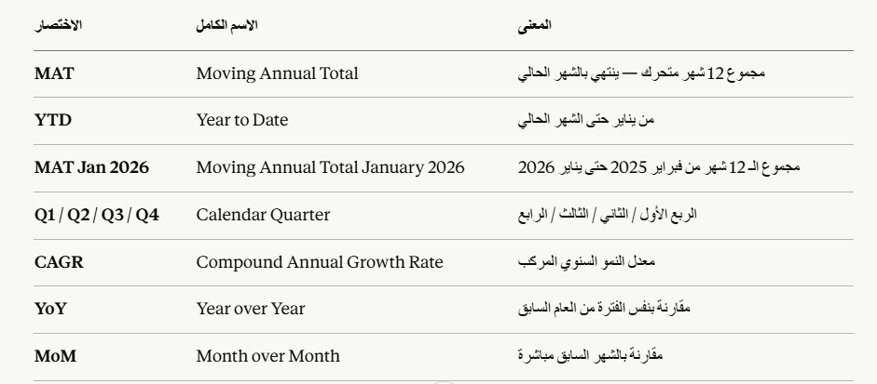
Time Period Abbreviations

Slide 10
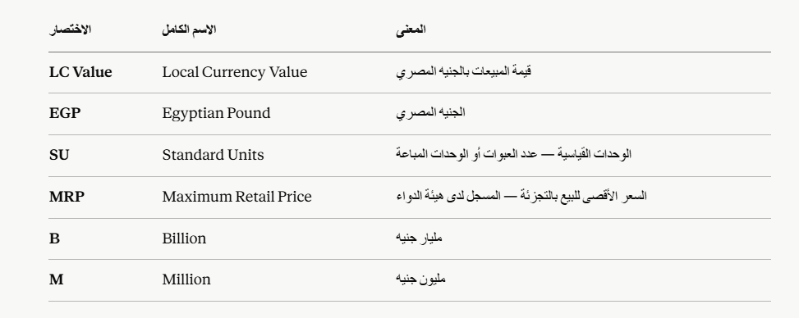
Sales & Value Abbreviations

Slide 11
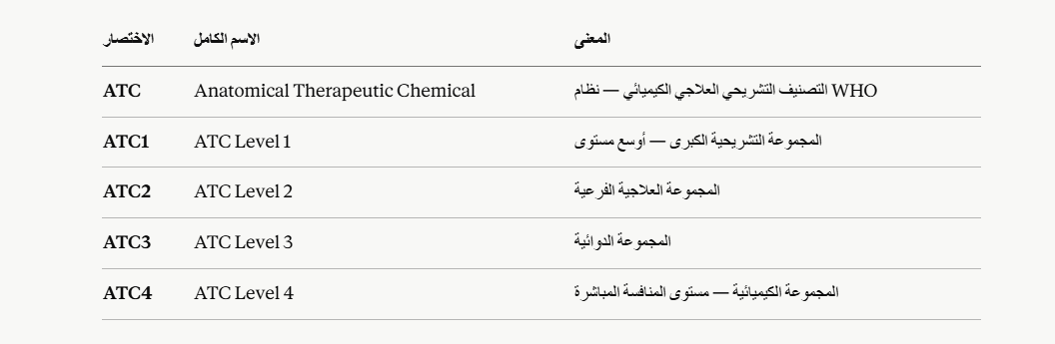
ATC Classification

Slide 12
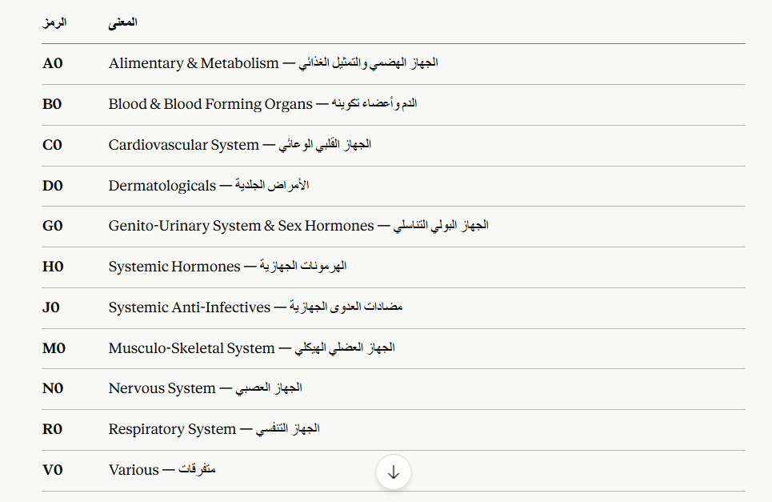
ATC Symbols

Slide 13
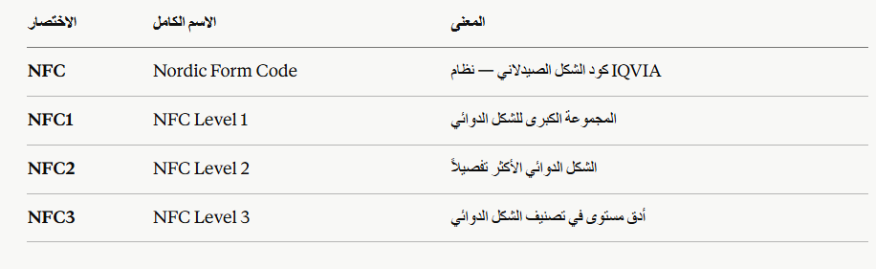
NFC Classification (Pharmaceutical Form)

Slide 14
NFC Classification (Pharmaceutical Form)

Slide 15
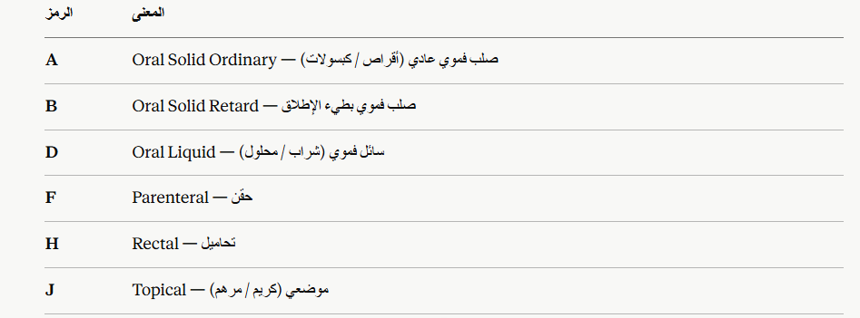
NFC Symbols

Slide 16
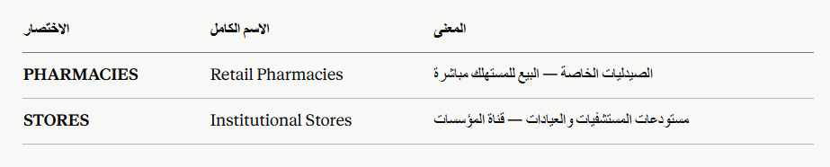
Market Channel Abbreviations

Slide 17
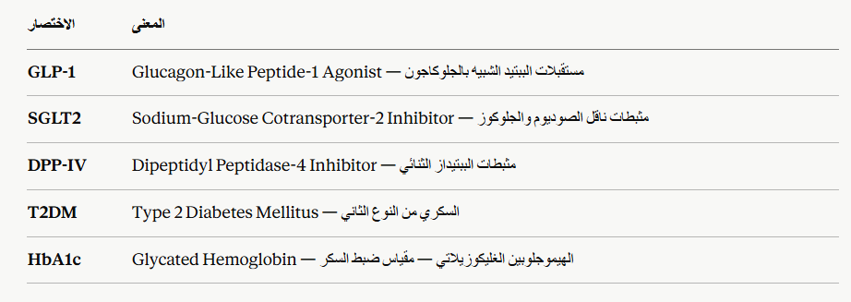
Diabetes-Specific ATC4 Abbreviations

Slide 18
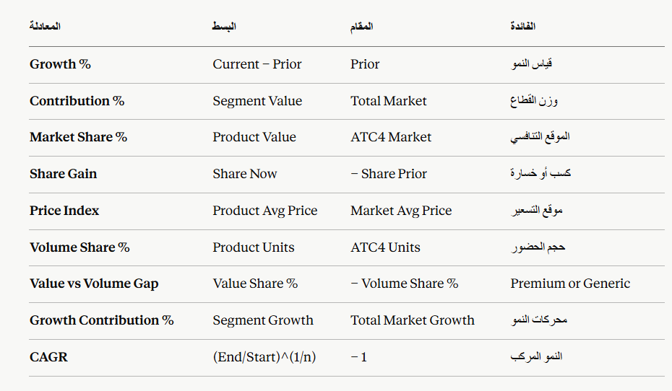
Some Abbreviations

Slide 19
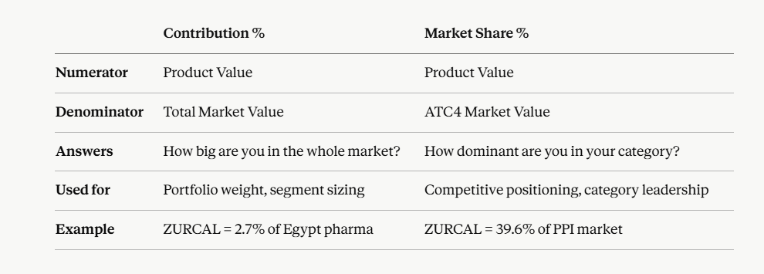
Contribution % vs Market Share %
Contribution % = Your share of the entire market
Market Share % = Your share of your competitive market (ATC4)

Slide 20


Slide 21
Performance Analysis
1-What is the total LC value and unit volume of the Egyptian pharmaceutical market for the most recent MAT period, and how does it compare to the prior year?
2-Which corporation holds the largest market share by value in the current MAT period, and by how many percentage points does it lead the second-ranked player?
3-Which manufacturer commands the highest market share, and what percentage of total market value does it represent?
4-What is the top-ranked product by market value, and how does its retail price position it relative to the segment average?
5-Which product currently holds the lowest performance ranking, and what is its trajectory — is it recovering or continuing to decline?

Slide 22
Trend Analysis
1-How has the total market value evolved across each MAT year from 2021 to 2026, and where do the most significant inflection points occur?
2-Is the Egyptian pharmaceutical market showing parallel growth in both value and unit volume, or is value growing faster than volume — signaling price-led rather than demand-led expansion?
3-Which therapeutic classes (ATC1 level) are on a consistent multi-year growth trajectory, and which have shown deceleration or contraction over the same period?
4-For the fastest-growing corporation, what is the year-over-year growth percentage, and is this growth consistently sustained or driven by a single outlier year?
5-How have the unit volumes across different dosage forms evolved year over year — are injectable formats gaining share relative to oral solid forms?
6-What is the 5-year compound annual growth rate (CAGR) for unit volume across the total market, and which corporations are outpacing or trailing this benchmark?

Slide 23
Regional & Geographical Insights
1-Which Egyptian governorates generate the highest pharmaceutical sales by unit volume, and what is the concentration ratio — do the top 3 governorates account for the majority of national volume?
2-Which governorates are significantly under-performing relative to their population size, representing the largest gap between demographic weight and pharmaceutical penetration?
3-Are there regional differences in therapeutic class preference — do specific governorates show disproportionately high consumption of particular ATC1 categories?
4-How does the public (hospital) sector compare to the private (retail) sector in terms of unit volume share by region, and which governorates show the highest hospital channel dependency?

Slide 24
Product Performance
1-Which are the top 7 products by market share, and collectively what percentage of total market value do they represent — indicating the degree of blockbuster dependency?
2-What percentage of the product portfolio is in the Growth lifecycle stage versus Maturity and Decline — and does the current pipeline adequately replace maturing assets?
3-Among the pivot table product rankings, which products show a significant divergence between their value rank and their unit volume rank — suggesting premium pricing versus generic volume strategies?
4-Which ATC2-level therapeutic sub-classes represent the largest unit volume blocks within the market, as revealed by the treemap, and are these the same classes showing the strongest growth?
5-For a given ATC1 therapeutic class, which specific products are ranked in the top 5 by unit volume, and how has their unit performance trended across the last three MAT periods?
6-Which products launched within the last 3 years (via Launch Year filter) have achieved the fastest trajectory to significant market share, signaling successful launch execution?

Slide 25
Competitive Intelligence
1-Which corporations are gaining market share year over year, and which are experiencing structural share erosion — despite the overall market growing?
2-Which corporation is identified as underperforming relative to market benchmarks, and in which therapeutic classes or regions is this underperformance most pronounced?
3-How is the corporate competitive landscape structured — is the market highly concentrated among 2-3 dominant players, or is it fragmented with multiple mid-size competitors?
4-How does the growth contribution of each corporation compare to its absolute market share — are small-share companies delivering outsized growth contributions or are the large incumbents driving most incremental volume?
5-Which manufacturer is gaining the fastest growth momentum, and does this growth correlate with a specific dosage form specialization or therapeutic focus area?

Slide 26
Strategic Decision-Making Questions
1-Based on the current 5-year CAGR and market trajectory, which therapeutic classes should be designated as strategic investment priorities for the next planning cycle?
2-If a corporation is considering geographic expansion, which 3 governorates should it prioritize based on the combination of high population, currently low penetration, and strong ATC-class relevance?
3-Which manufacturer should a corporation evaluate as a potential strategic partner or acquisition target based on portfolio breadth, dosage form specialization, and growth trajectory?
4-For a new product launch in a specific therapeutic class, which existing products represent the primary competitive set, what is the current market leader's share, and what minimum market share threshold is commercially viable?
5-Considering the current distribution of products across lifecycle stages (Introduction, Growth, Maturity, Decline), what is the projected revenue sustainability of the market over the next 3-5 years without new product launches?
6-Given the identified underperforming corporation and its specific product weaknesses, what defensive commercial actions should market-leading competitors prioritize to consolidate and expand their advantage?

Slide 27
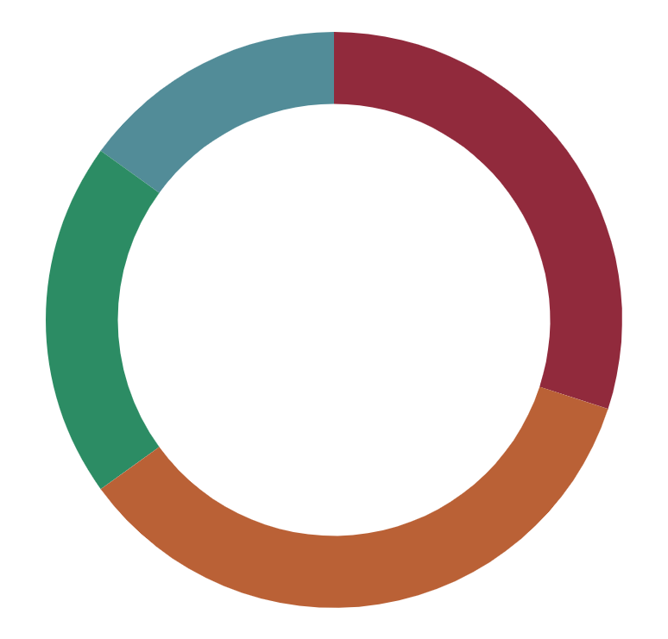
Market Channel Distribution
15%
30%
Pharmacies
Generics
Pharmacies (retail) — primary OTC and prescription sales channel
Generic Products — unbranded molecules competing on price in ATC4 segments
20%
35%
Stores
Innovators
Hospital Stores — institutional and in-patient prescription dispensing
Innovator Brands — originator products with premium pricing and patent protection

Slide 28
Data Cleaning
02

Slide 29
Data Cleaning Workflow
Replace nulls, deduplicate at Product+Pack+Sector+Period grain.
Strip asterisks, trim, parse Launch Date, clean Corp names.
Import Excel file via Get Data → Transform Data. Never click Load directly.
Correct data types: Period → Date, LC Value → Fixed Decimal, Units → Decimal.
Connect
Fix Types
Clean \& Deduplicate
Standardize
01
02
03
04

Slide 30
Power Query Transformation Checklist
 | Data Types | Null Handling | Deduplication | Text Cleaning
Change Period to Date, LC Value to Fixed Decimal, retain Units as Decimal
Replace nulls: LC Value/Units → 0, ATC1-4 → UNCLASSIFIED, Corporation → UNKNOWN
Remove duplicate rows on Product+Pack+Sector+Period grain; validate LC Value before/after
Strip asterisks from Calendar Year and Corporation; trim whitespace; parse Launch Date YYYY/MM

Slide 31
DAX Measures Library
03

Slide 32
DAX Optimization Rules
Apply these rules to ensure your Power BI model runs fast and accurately:
Always use VAR variables — they evaluate expressions once and cache results, cutting query time by up to 50%
Replace FILTER(ALL()) with direct CALCULATE() filter arguments — avoids expensive table scans
Use ALLSELECTED (not ALL) for market share — respects user slicer context for ATC4 competitive markets
Enable Import Mode and disable Auto Date/Time — 10x faster than DirectQuery; eliminates hidden date tables that double model size

Slide 33
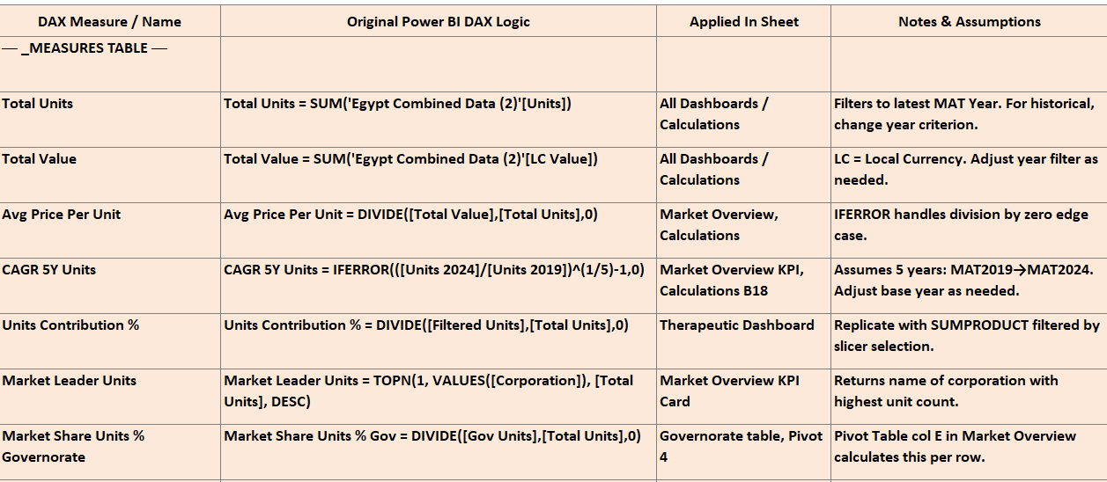

Slide 34
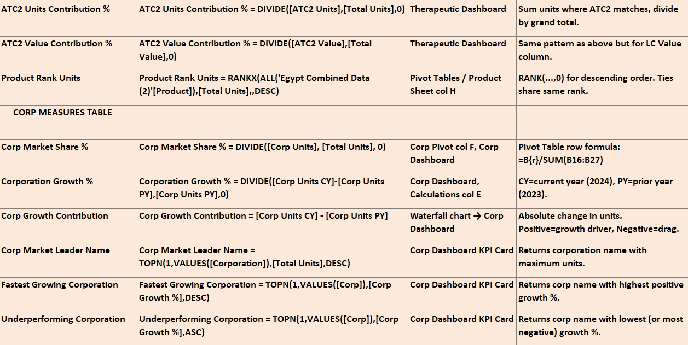

Slide 35
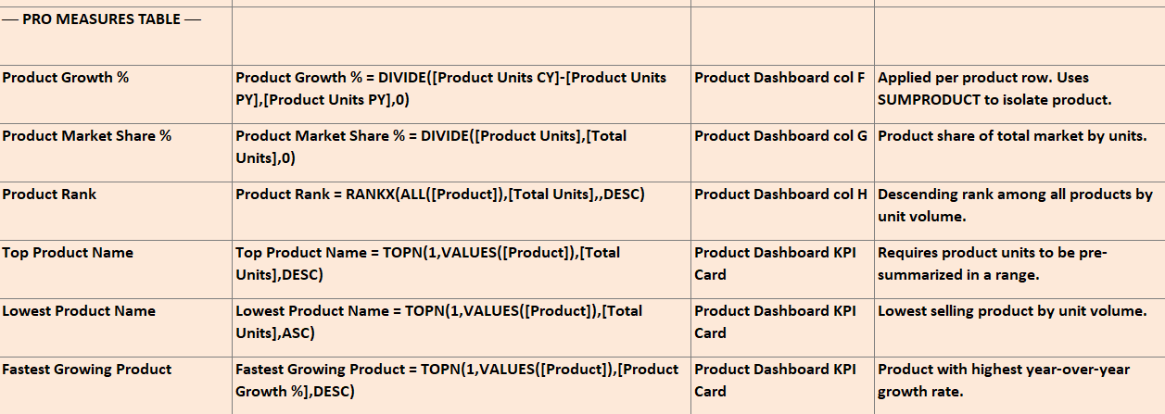

Slide 36
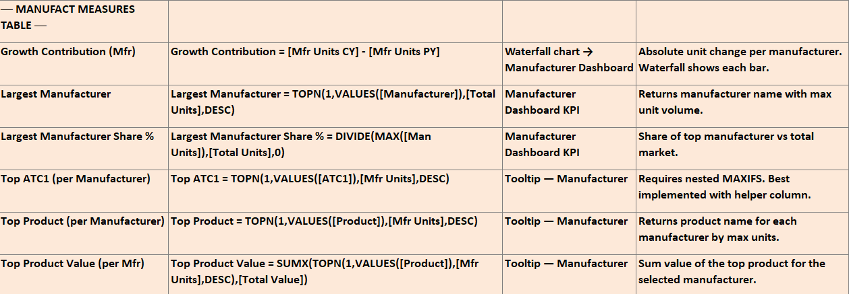

Slide 37
Dashboard Design
04

Slide 38
316,330
Total pharmaceutical sales data rows in the Egypt IQVIA dataset powering the enterprise dashboard

Slide 39
Where we are
Where we want to be
Raw IQVIA Excel data: 316,330 unstructured rows, mixed data types, asterisked text, unparsed dates, and no calculated KPIs
Enterprise Power BI Dashboard: real-time MAT/YTD KPIs, drill-through, market share, RLS governance, and executive self-service analytics

Slide 40
Implementation Roadmap
01
02
Import & Clean Data
DAX Measures Library
03
04
Build Data Model
Design & Deploy
Connect Excel source, fix data types, handle nulls, deduplicate, and standardize text (1.5 days)
Build all KPI, growth, market share, ranking, and advanced analytics measures (2 days)
Create Date Table, build calculated columns (time, MAT/YTD flags, lifecycle, price segments) (1.5 days)
Build 10 dashboard pages, add interactivity, configure RLS, publish to Power BI Service (4.5 days)

Slide 41

Visualization always reinforces the insight
A Power BI,Tableau and Excel dashboards reveals pharmaceutical market insights in seconds that would take analysts hours to discover in raw Excel data

Slide 42
3,190
797
11
Unique pharmaceutical products in the dataset
Marketing authorization holders (corporations)
WHO ATC1 therapeutic area classes

Slide 43
Dashboard Pages Overview
Product Analysis
Competitive Intelligence
Advanced Analytics
Market Overview
ATC Analysis
Corporation Rankings
Product KPIs, ABC Pareto, lifecycle analysis, pack mix, and strength distribution
ATC4-level competitor benchmarking, share vs. growth scatter, price index analysis
Decomposition tree, ABC analysis, seasonality heatmap, and cannibalization detection
Total market KPIs, MAT growth, sector comparison, and top ATC1 treemap
Therapeutic area deep-dive, ATC4 market share matrix, drill-down hierarchy
Corporate league table, ribbon chart, portfolio footprint and growth decomposition

Slide 44

Power BI Dashboard
Build your data model, write DAX measures, and design dashboard layouts in Power BI Desktop before publishing to the cloud.

Slide 45
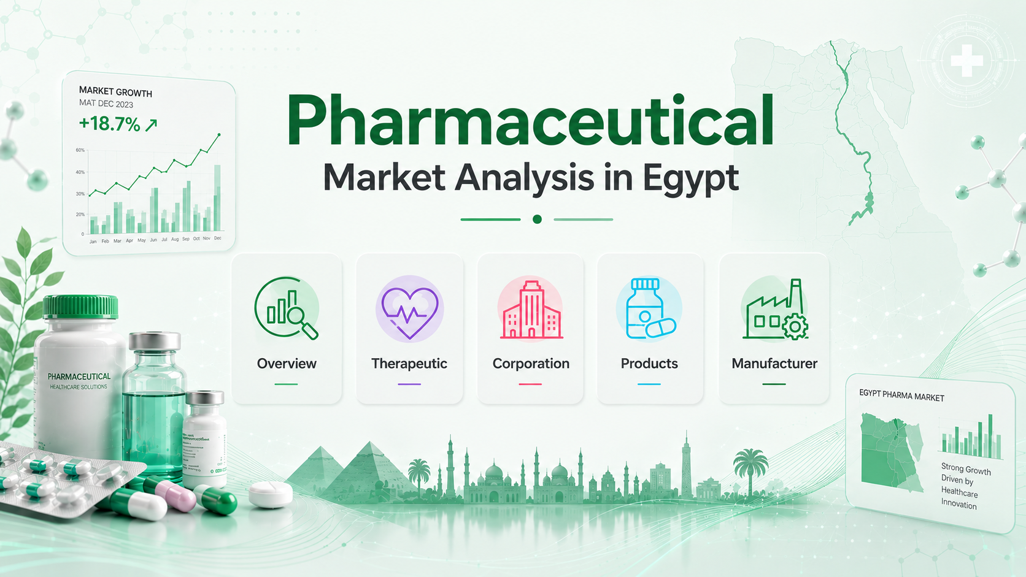

Slide 46
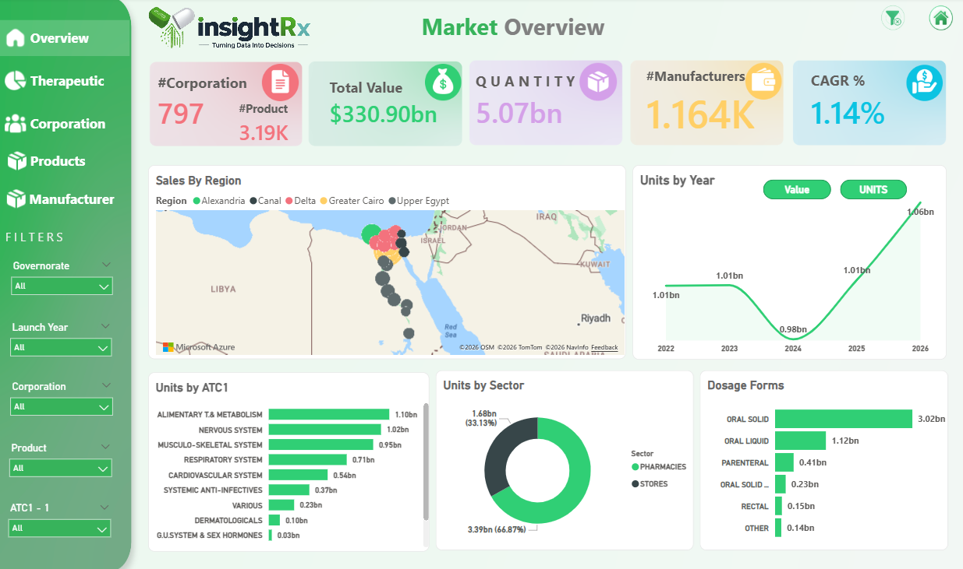

Slide 47
Market Overview Dashboard – InsightRx
This dashboard provides a high-level snapshot of the pharmaceutical market, covering 797 corporations and 3,190 products across Egypt. Total market value stands at $330.90bn with a quantity of 5.07bn units, supplied by 1,164 manufacturers at a CAGR of 1.14%. Sales are mapped by region (Alexandria, Canal, Delta, Greater Cairo, Upper Egypt), while unit trends show a recovery to 1.06bn units in 2026 after a 2024 dip. Top therapeutic categories include Alimentary & Metabolism and Nervous System. Pharmacies dominate distribution at 66.87%, and oral solid forms lead dosage types at 3.02bn units.

Slide 48
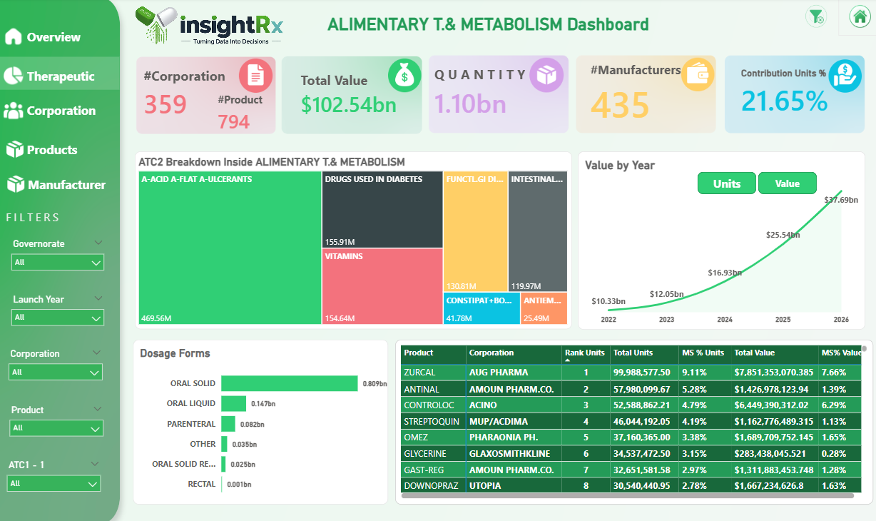

Slide 49
Alimentary T.& Metabolism Dashboard – InsightRx
This dashboard focuses on the Alimentary & Metabolism therapeutic category, representing 21.65% of total market units. It covers 359 corporations, 794 products, and 435 manufacturers, with a total value of $102.54bn and 1.10bn units. The ATC2 breakdown highlights key sub-categories led by Acid/Ulcerants (469.56M), Drugs Used in Diabetes (155.91M), and Vitamins (154.64M). Market value shows strong growth, reaching $37.69bn in 2026. Oral solid forms dominate dosage types at 0.809bn units. Top products include Zurcal (Aug Pharma) ranked #1 with ~100M units, followed by Antinal (Amoun) and Contraloc (Acino).

Slide 50
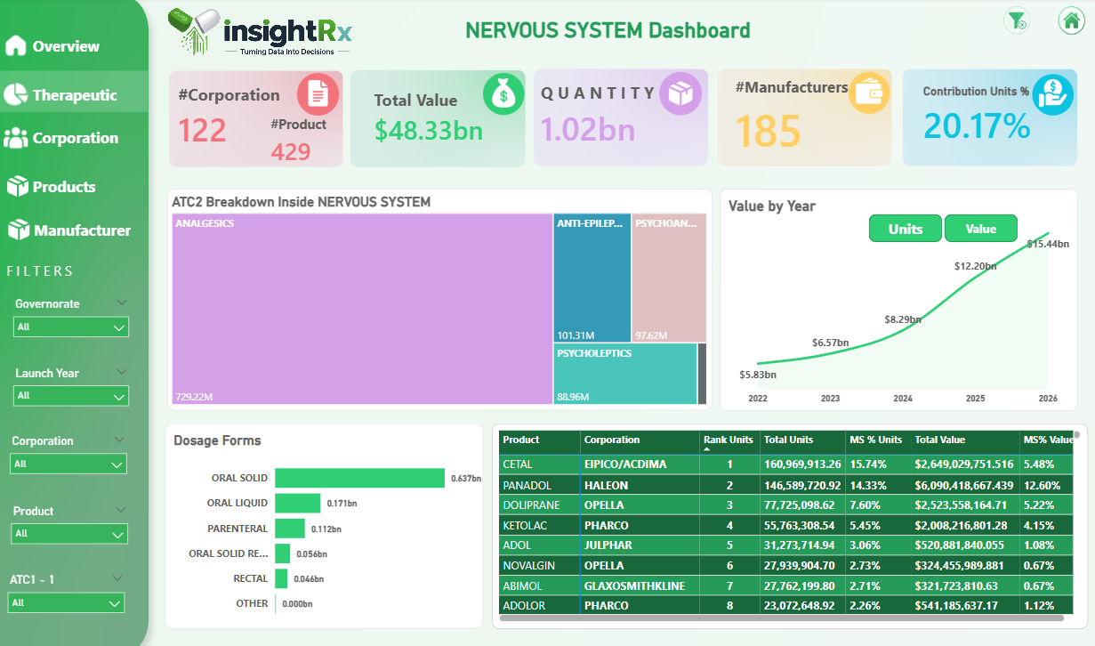

Slide 51
Nervous System Dashboard – InsightRx
This dashboard covers the Nervous System therapeutic category, contributing 20.17% of total market units. It includes 122 corporations, 429 products, and 185 manufacturers, with a total value of $48.33bn and 1.02bn units. The ATC2 breakdown is dominated by Analgesics (729.22M units), followed by Anti-Epileptics (101.31M), Psychoanaleptics (97.62M), and Psycholeptics (88.96M). Market value grew sharply to $15.44bn in 2026. Oral solid forms lead dosage types at 0.637bn units. Top products include Cetal (EIPICO/ACDIMA) at #1 with ~161M units, followed by Panadol (Haleon) and Doliprane (Opella).Sonnet 4.6

Slide 52
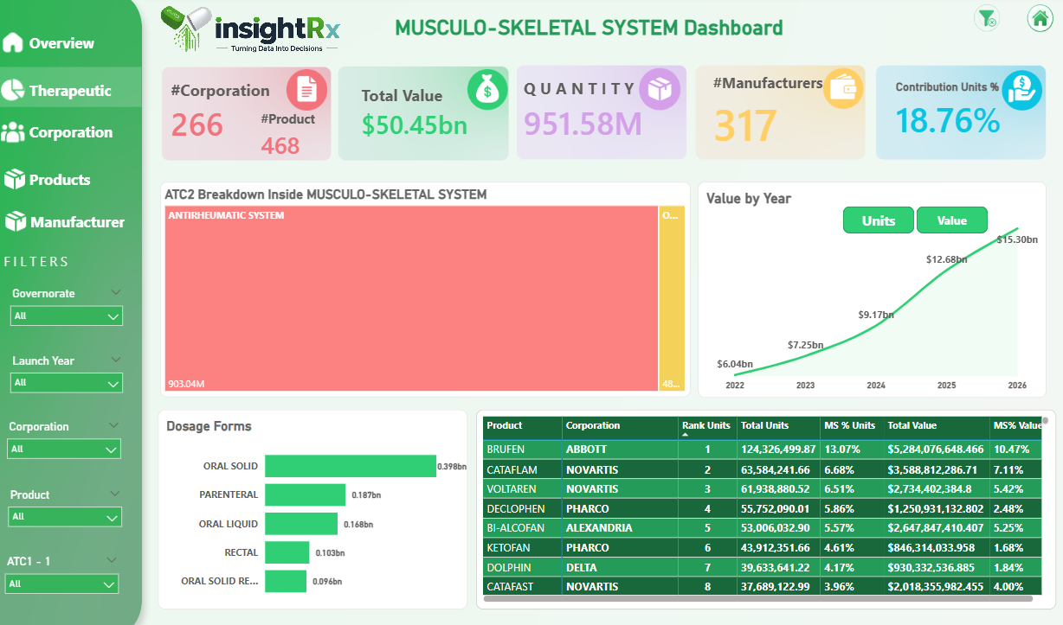

Slide 53
Musculo-Skeletal System Dashboard – InsightRx This dashboard covers the Musculo-Skeletal System category, contributing 18.76% of total market units. It includes 266 corporations, 468 products, and 317 manufacturers, with a total value of $50.45bn and 951.58M units. The ATC2 breakdown is heavily dominated by Antirheumatic System products (903.04M units). Market value grew steadily to $15.30bn in 2026. Oral solid forms lead dosage types at 0.398bn units, followed by Parenteral (0.187bn). Top products include Brufen (Abbott) at #1 with ~124M units, followed by Cataflam and Voltaren (both Novartis).

Slide 54
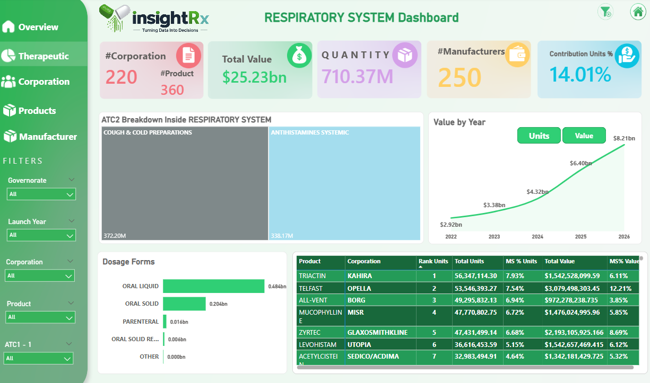

Slide 55
Respiratory System Dashboard – InsightRx
This dashboard covers the Respiratory System category, contributing 14.01% of total market units. It includes 220 corporations, 360 products, and 250 manufacturers, with a total value of $25.23bn and 710.37M units. The ATC2 breakdown is split between Cough & Cold Preparations (372.20M) and Antihistamines Systemic (338.17M). Market value grew strongly to $8.21bn in 2026. Oral liquid forms lead dosage types at 0.484bn units. Top products include Triactin (Kahira) at #1 with ~56M units, followed by Telfast (Opella) and All-Vent (Borg).

Slide 56
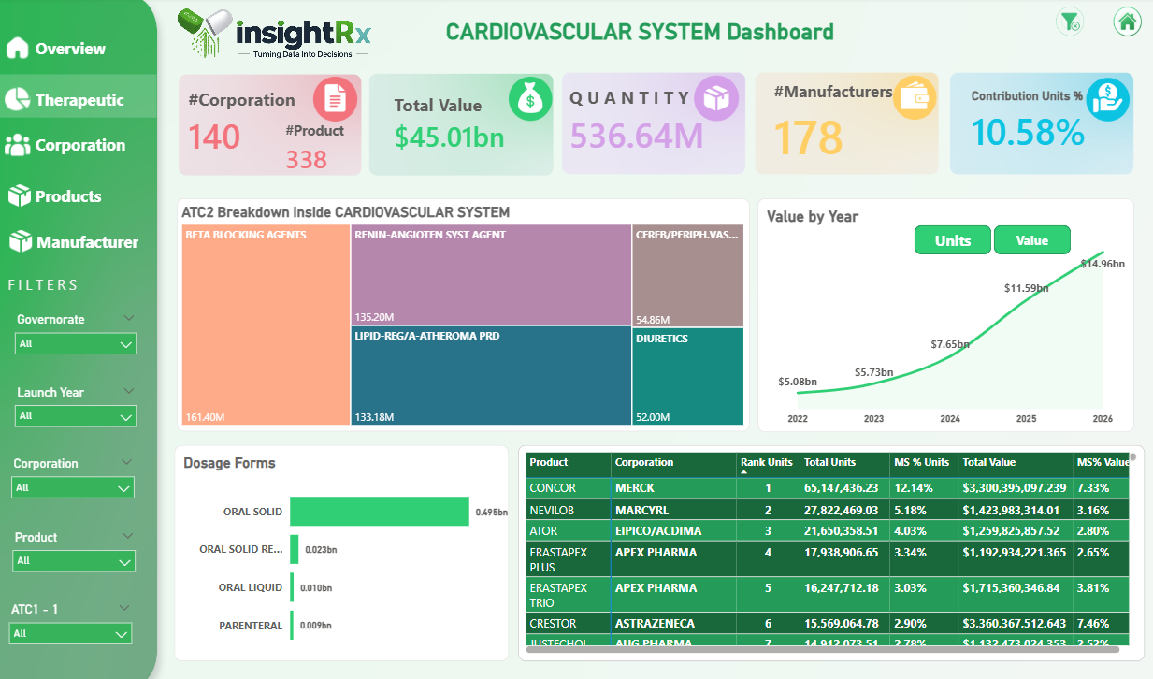

Slide 57
Cardiovascular System Dashboard – InsightRx
This dashboard covers the Cardiovascular System category, contributing 10.58% of total market units. It includes 140 corporations, 338 products, and 178 manufacturers, with a total value of $45.01bn and 536.64M units. The ATC2 breakdown highlights Beta Blocking Agents (161.40M), Renin-Angiotensin System Agents (135.20M), Lipid-Regulating/Atheroma Products (133.18M), and Diuretics (52.00M). Market value grew sharply to $14.96bn in 2026. Oral solid forms dominate at 0.495bn units. Top products include Concor (Merck) at #1 with ~65M units, followed by Nevilob (Marcyrl) and Ator (EIPICO/ACDIMA).

Slide 58
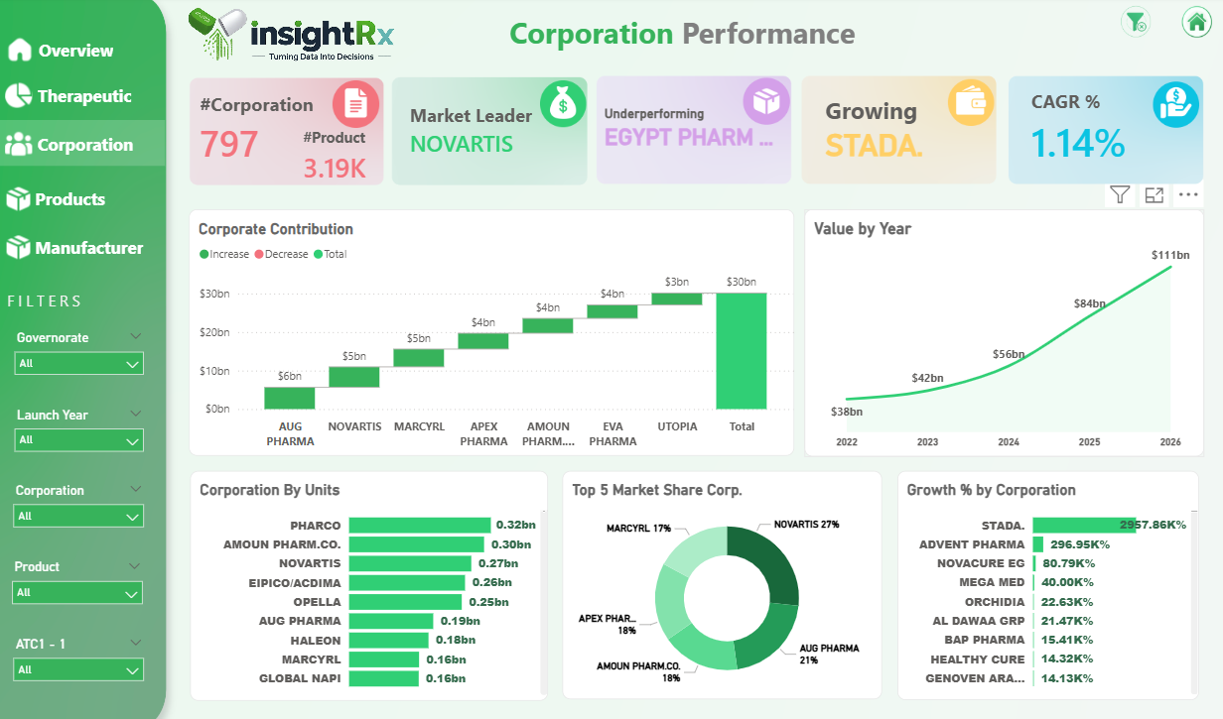

Slide 59
Corporation Performance Dashboard – InsightRx
This dashboard evaluates performance across 797 corporations and 3,190 products. Novartis leads as market leader, while Egypt Pharm is flagged as underperforming and Stada is the fastest growing corporation with a remarkable 2,957.86% growth. Overall market CAGR stands at 1.14%, with total value reaching $111bn in 2026. Top corporations by units are Pharco (0.32bn), Amoun (0.30bn), and Novartis (0.27bn). The top 5 market share is led by Novartis (27%), followed by Aug Pharma (21%), Amoun (18%), Apex Pharma (18%), and Marcyrl (17%). Key contributors to value growth include Aug Pharma, Novartis, and Utopia.

Slide 60
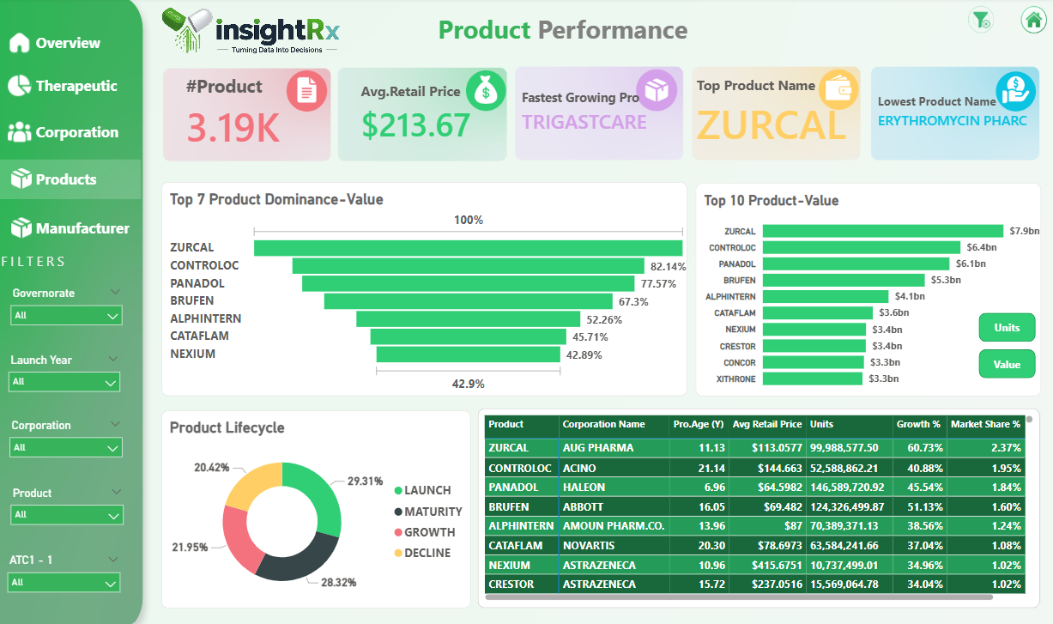

Slide 61
Product Performance Dashboard – InsightRx
This dashboard analyzes 3,190 products with an average retail price of $213.67. Trigastcare is the fastest growing product, Zurcal is the top product by value, and Erythromycin Pharc ranks lowest. Zurcal leads dominance at 100%, followed by Controloc (82.14%), Panadol (77.57%), and Brufen (67.3%). By value, the top products are Zurcal ($7.9bn), Controloc ($6.4bn), and Panadol ($6.1bn). The product lifecycle shows 44.29% in Maturity, 30.21% in Decline, 19.84% in Growth, and 5.65% in Launch stage. Top performers by growth include Zurcal (60.73%), Controloc (40.88%), and Panadol (45.54%).

Slide 62
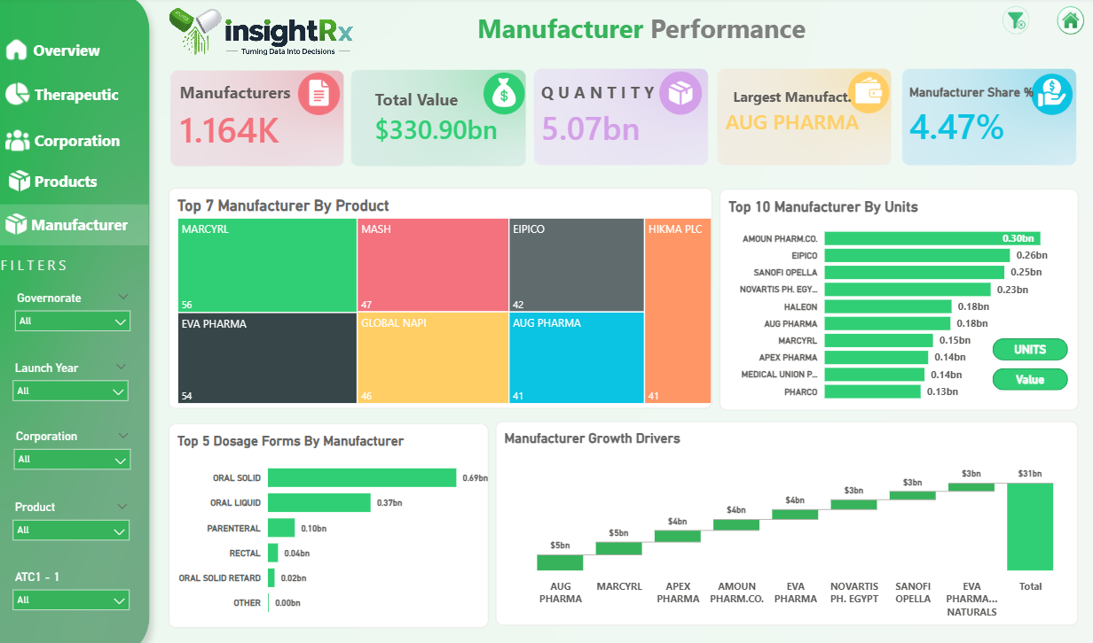

Slide 63
Manufacturer Performance Dashboard – InsightRx
This dashboard covers 1,164 manufacturers with a total market value of $330.90bn and 5.07bn units. Aug Pharma is the largest manufacturer with a 4.47% market share. Top manufacturers by product count are Marcyrl (56), Eva Pharma (54), Mash (47), and Global Napi (46). By units, Amoun Pharm.Co. (0.30bn) leads, followed by EIPICO (0.26bn) and Sanofi Opella (0.25bn). Oral solid forms dominate dosage output at 0.69bn units. Key growth drivers include Aug Pharma, Marcyrl, Apex Pharma, and Amoun, collectively contributing to a $31bn total growth figure.

Slide 64

Tableau Dashboard

Slide 65
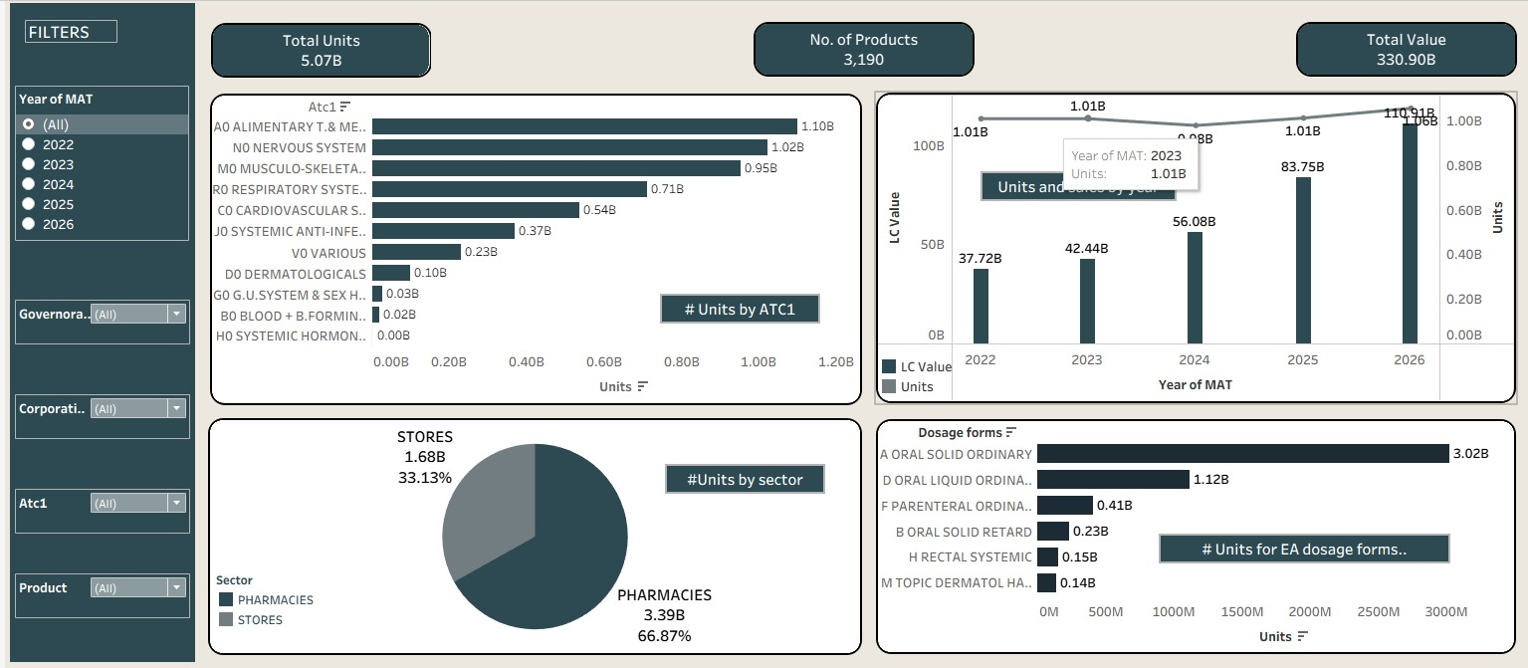
Market Overview

Slide 66
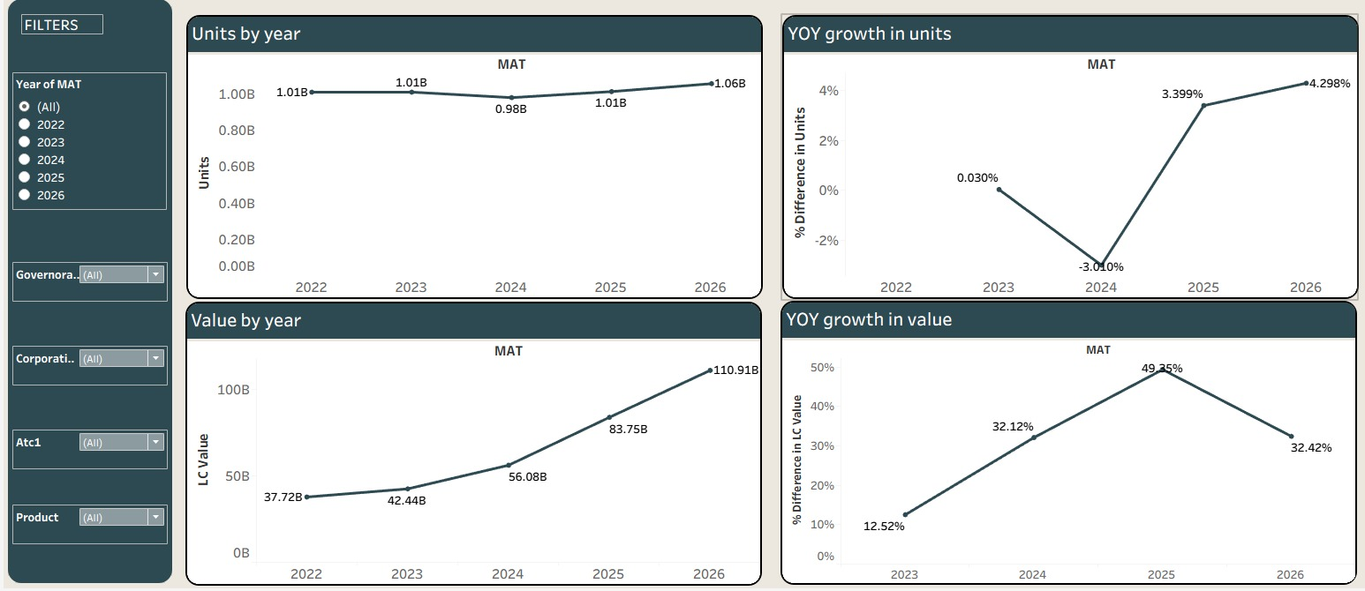
Market Overview

Slide 67
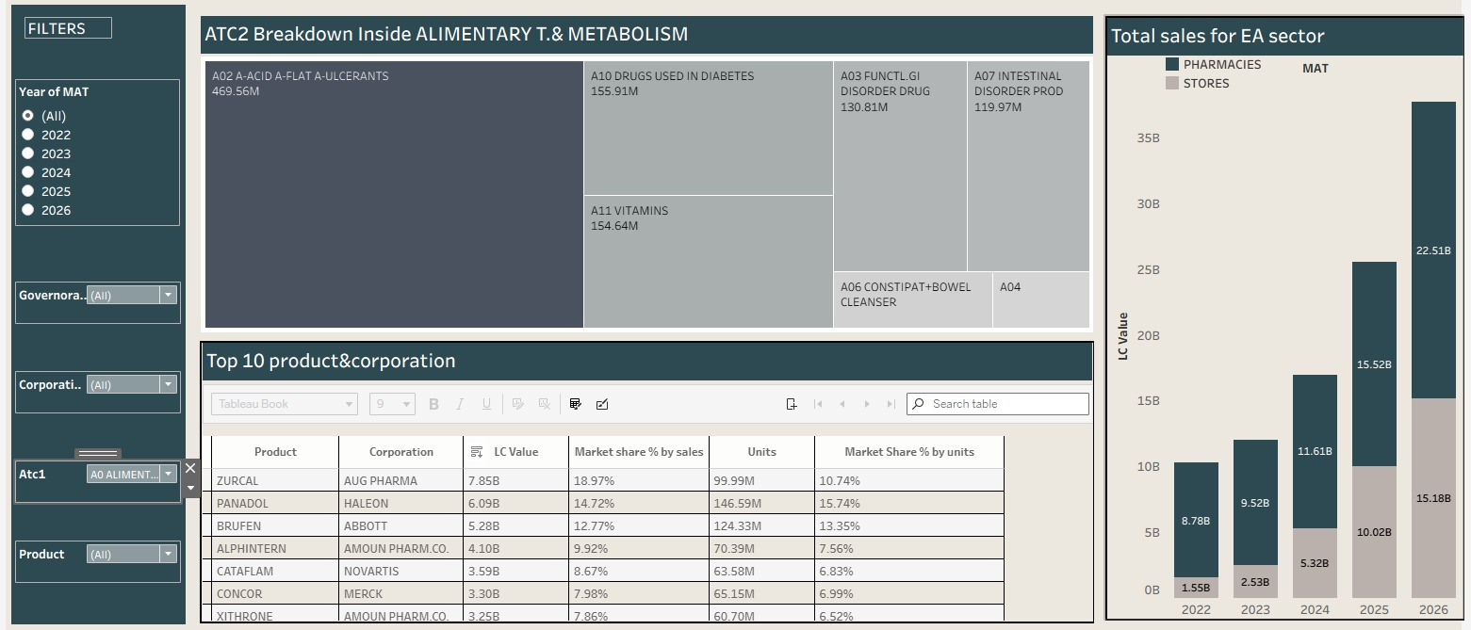
Therapeutic Analysis

Slide 68
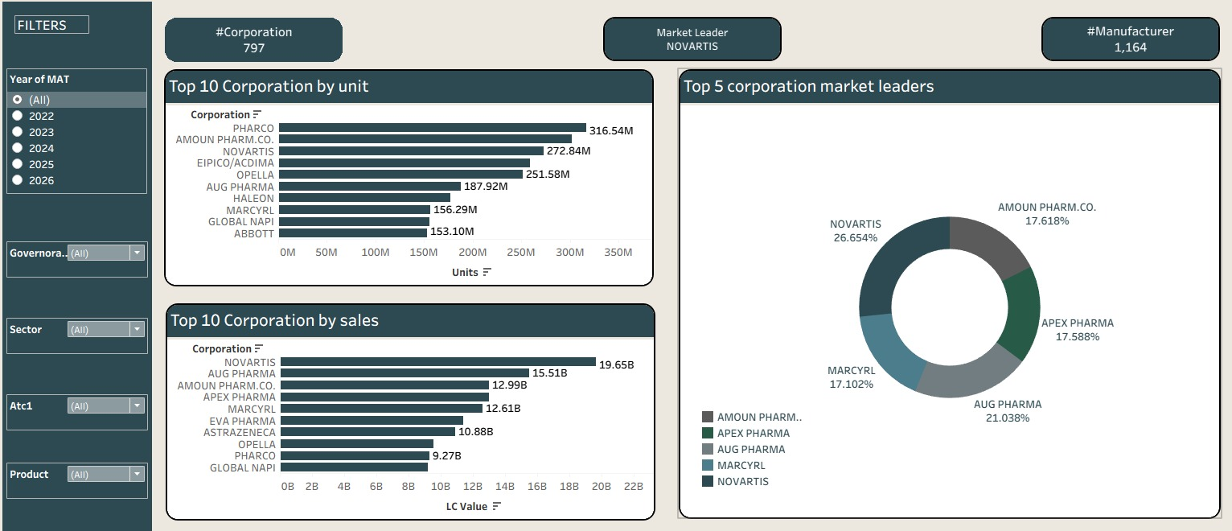
Corporation Performance

Slide 69
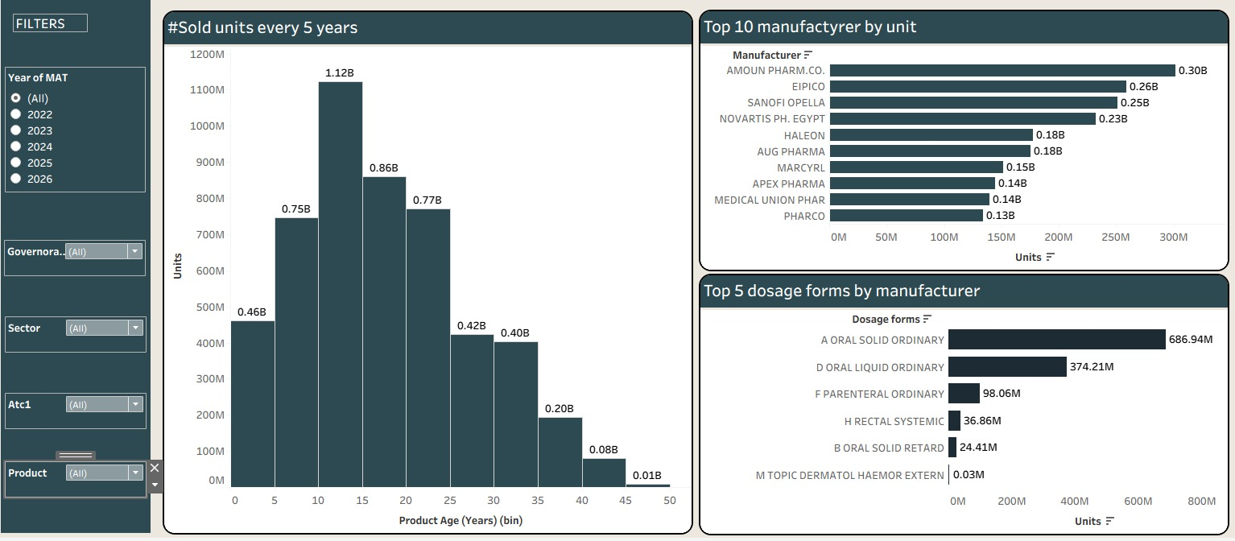
Manufacturer Performance

Slide 70

Excel Dashboard

Slide 71
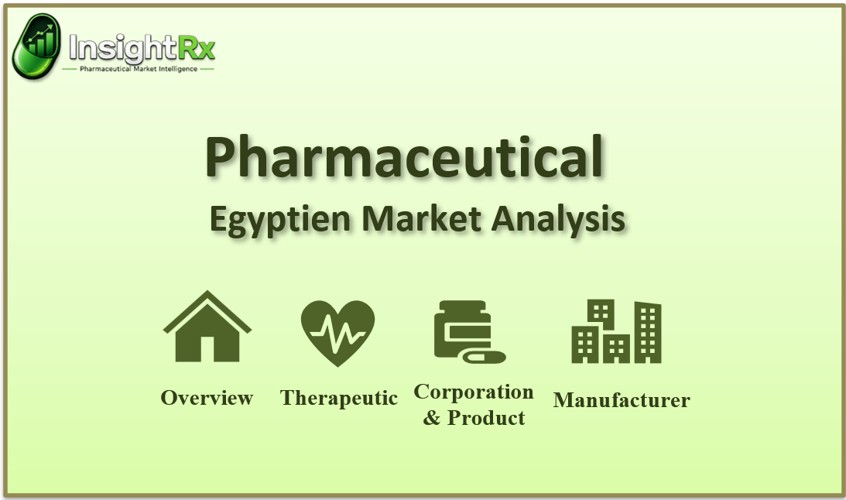

Slide 72
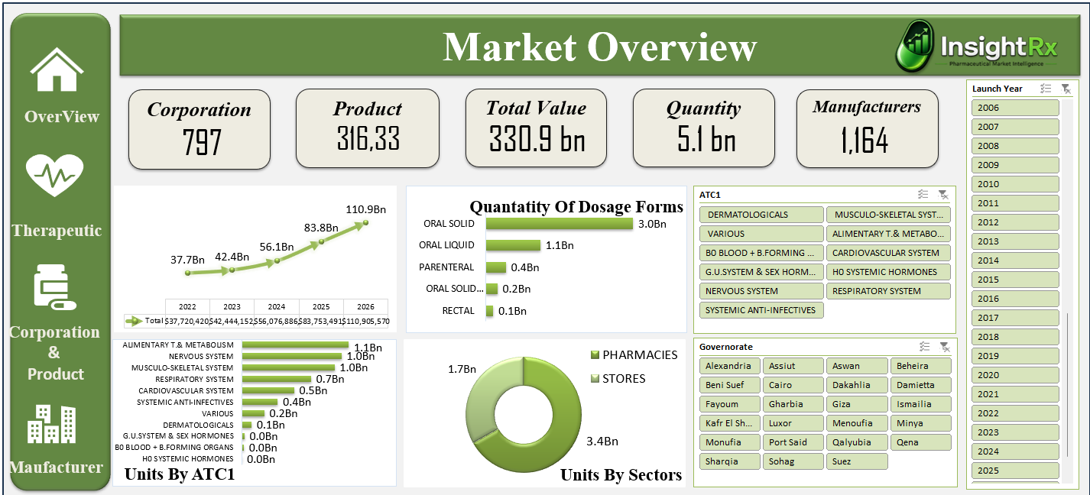

Slide 73
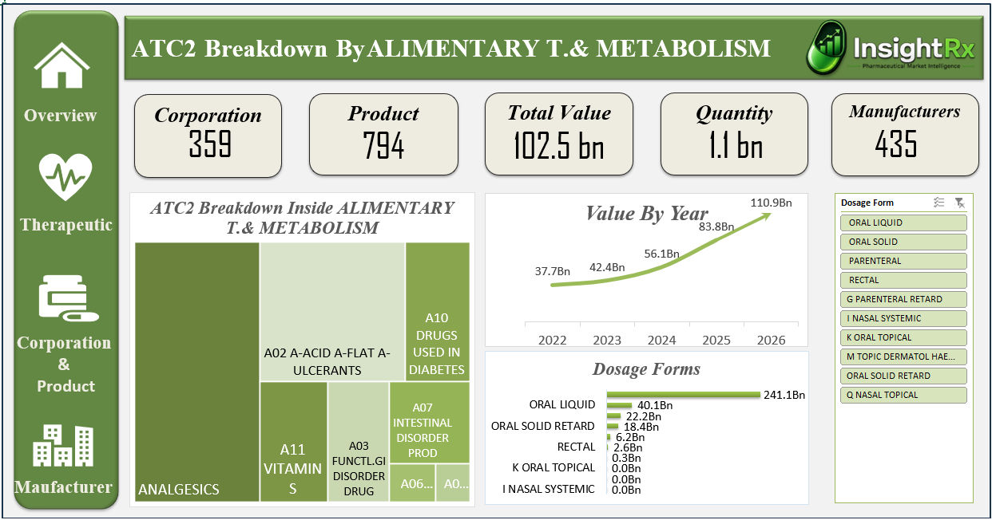

Slide 74
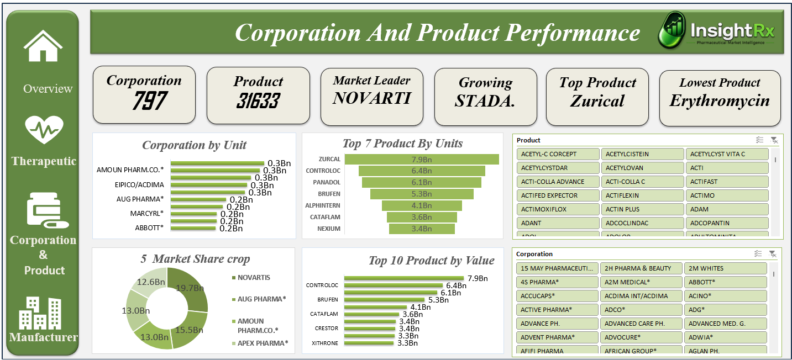

Slide 75
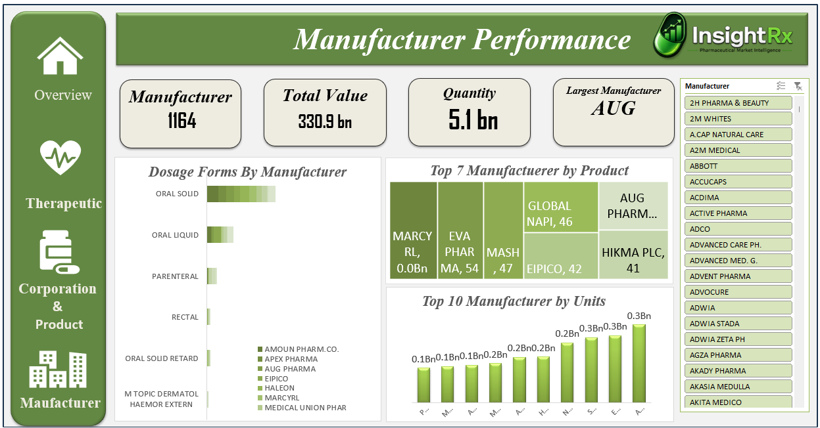

Slide 76
Insights
05

Slide 77
Market Overview
EGP 110.9B Total Market | +32.4% Value Growth | MAT January 2026

Slide 78
Market Scale & Growth Metrics
EGP 110.9 Billion
+32.4% Value Growth
+4.3% Units Growth
Total Market Value MAT Jan 2026 — up from EGP 83.7B in 2025. 4-Year CAGR: 30.9%.
YoY growth driven by 181% price inflation (EGP 37 to EGP 105/unit). Volume recovered +4.3% — a positive signal after years of stagnation.
1.057 billion units sold MAT 2026. Stores channel growing 1.9x faster than pharmacies at 45.8% vs 24.3%.

Slide 79
EGP 110.9B Total Market MAT 2026 ↑ from 83.7B in 2025 | +32.4% Value Growth YoY Above inflation trajectory | +4.3% Units Growth YoY Units: 1.06B → 1.06B | 30.9% 4-Year CAGR MAT 2022→2026 | +181% Avg Price Inflation EGP 37 → EGP 105/unit
Market Growth - 2022 to 2026
Period | Market Value (EGP) | YoY Growth | Volume (Units) | Avg Price/Unit
MAT Jan 2022 | 37.72 billion | Baseline | 1.010 billion | EGP 37.33
MAT Jan 2023 | 42.44 billion | +12.5% | 1.028 billion | EGP 41.28
MAT Jan 2024 | 56.08 billion | +32.2% | 1.007 billion | EGP 55.66
MAT Jan 2025 | 83.75 billion | +49.4% | 1.013 billion | EGP 82.63
MAT Jan 2026 | 110.91 billion | +32.4% | 1.057 billion | EGP 104.91
Pharmacies vs. Stores — Channel
Channel | MAT 2026 (EGP) | Market Share | YoY Growth | Strategic Signal
PHARMACIES | 64.68 Billion | 58.3% | +24.3% | Slower — channel saturation, OTC price sensitivity
STORES (Hospital/Clinic) | 46.22 Billion | 41.7% | +45.8% | Accelerating — hospital channel is gaining share of wallet
Total Market | 110.91 Billion | 100% | +32.4% | Stores growing 1.9x faster than Pharmacies

Slide 80
Therapeutic Class Insights
ATC Class Performance | The Diabetes Mega-Story | Vitamins Boom

Slide 81
ATC Class Performance Matrix
ATC1 Class | MAT 2026 | Market Share | YoY Growth | 4Y CAGR | Avg Price | Assessment
A0 ALIMENTARY & METABOLISM | 37.69B | 34.0% | +47.6% | 38.2% | EGP 148 | DOMINANT & ACCELERATING
N0 NERVOUS SYSTEM | 15.44B | 13.9% | +26.6% | 27.6% | EGP 78 | Stable core
M0 MUSCULO-SKELETAL | 15.30B | 13.8% | +20.7% | 26.1% | EGP 88 | Below market avg
C0 CARDIOVASCULAR | 14.96B | 13.5% | +29.0% | 31.0% | EGP 125 | Premium & growing
J0 ANTI-INFECTIVES | 8.29B | 7.5% | +17.9% | 22.8% | EGP 104 | Losing share
R0 RESPIRATORY | 8.21B | 7.4% | +28.3% | 29.5% | EGP 58 | Volume-driven
D0 DERMATOLOGICALS | 2.17B | 2.0% | +64.9% | 39.1% | EGP 81 | 🔥 BREAKOUT
B0 BLOOD & ORGANS | 2.17B | 2.0% | +38.9% | 21.1% | EGP 367 | Premium specialty
H0 SYSTEMIC HORMONES | 0.09B | 0.1% | +105.4% | 209.2% | EGP 173 | EMERGING NICHE

Slide 82
THE DIABETES MEGA-STORY
EGP 14.51B Diabetes Market MAT 2026 #1 ATC2 Class | +54.1% YoY Growth Fastest large ATC2 | 48.3% 4Y CAGR Compounding explosively | EGP 4.21B GLP-1 Sub-segment +158% in 1 year
Diabetes Segment (ATC4) | MAT 2026 | Growth | Avg Price | Competition (HHI) | Opportunity
GLP-1 Agonists (A10S0) | 4.21B | +158% | EGP 4,711 | 0.51 — Duopoly | DEFEND/JOIN
DPP-IV + Biguanide Combo (A10N3) | 3.62B | +24% | EGP 216 | 0.13 — Fragmented | HIGH ENTRY OPTY
SGLT2 Plain (A10P1) | 2.34B | +30% | EGP 303 | 0.13 — Fragmented | HIGH ENTRY OPTY
SGLT2 + Biguanide (A10P3) | 1.04B | +22% | EGP 247 | 0.15 — Fragmented | GOOD ENTRY OPTY
SGLT2 + DPP-IV Combo (A10P5) | 0.58B | +98% | EGP 359 | 0.30 — Moderate | FAST ENTRY OPTY
SGLT2 + Other Combo (A10P9) | 0.77B | +179% | EGP 433 | 0.40 — Concentrated | MONITOR

Slide 83
Competitive Intelligence
Corporate League Table | Market Leaders | Competitive Findings | MAT Jan 2026

Slide 84
Corporate Table — MAT Jan 2026
# | Corporation | MAT 2026 | Mkt Share | YoY Growth | 4Y CAGR | Signal
1 | AUG PHARMA* | 5.65B | 5.2% | +51.5% | 35.1% | OUTPERFORMER
2 | NOVARTIS | 5.32B | 4.9% | +10.7% | 17.5% | LOSING SHARE
3 | MARCYRL* | 4.62B | 4.2% | +35.0% | 41.9% | OUTPERFORMER
4 | APEX PHARMA* | 4.11B | 3.8% | +7.2% | 30.7% | LOSING SHARE
5 | AMOUN PHARM* | 3.86B | 3.5% | +28.1% | 19.5% | NEUTRAL
6 | EVA PHARMA* | 3.50B | 3.2% | +22.2% | 27.9% | NEUTRAL
7 | UTOPIA* | 3.08B | 2.8% | +60.3% | 57.4% | STAR
8 | OPELLA* | 2.99B | 2.7% | +19.3% | 27.2% | NEUTRAL
9 | ASTRAZENECA* | 2.90B | 2.7% | -0.8% | 21.0% | ⚠ DECLINING
10 | PHARCO* | 2.87B | 2.6% | +23.6% | 26.5% | NEUTRAL
11 | LIMITLESS NATURALS | 2.86B | 2.6% | +78.6% | 140.7% | DISRUPTOR
12 | HALEON* | 2.83B | 2.6% | +37.0% | 38.9% | OUTPERFORMER
13 | GLOBAL NAPI* | 2.68B | 2.4% | -2.0% | 25.2% | ⚠ DECLINING
14 | ABBOTT* | 2.52B | 2.3% | +29.1% | 29.4% | OUTPERFORMER
15 | ELI LILLY* | 2.43B | 2.2% | +537.6% | 96.3% | 🚀 MOUNJARO

Slide 85
PRODUCT INSIGHTS

Slide 86
Top Products Driving the Market
# | Product | MAT 2026 | YoY Growth | 4Y CAGR | Retail Price | ATC2 | Status
1 | ZURCAL | 2.97B | +43.9% | 40.4% | EGP 113 | A02 Anti-Ulcerants | STAR
2 | PANADOL | 1.91B | +25.1% | 28.9% | EGP 80 | N02 Analgesics | Core
3 | CONTROLOC | 1.87B | +7.2% | 26.0% | EGP 145 | A02 Anti-Ulcerants | Maturing
4 | BRUFEN | 1.79B | +48.4% | 33.8% | EGP 71 | M01 Antirheumatics | Resurgent
5 | OZEMPIC | 1.25B | +80.1% | 126.0% | EGP 4,000 | A10 Diabetes | HIGH VALUE
6 | XITHRONE | 1.09B | +57.0% | 19.4% | EGP 75 | J01 Antibacterials | Star
7 | ZITHROMAX | 1.04B | +29.5% | 29.0% | EGP 119 | J01 Antibacterials | Core
8 | DOLIPRANE | 0.99B | +48.7% | 47.5% | EGP 51 | N02 Analgesics | RISING FAST
9 | MOUNJARO | 2.23B → #1 in Diabetes | +9,024% | >100% | EGP 14,543 | A10 GLP-1 | 🚀 PHENOMENON
10 | PANTHENOL | 0.82B | +219% | 87.1% | EGP 40 | D03 Wound Healing | DISRUPTOR

Slide 87
MANUFACTURER INSIGHTS

Slide 88
Leading Manufacturers MAT Jan 2026
# | Manufacturer | MAT 2026 | YoY Growth | Profile
1 | AUG PHARMA | 5.49B | +51.6% | Domestic leader — Vitamins + Gastrointestinal focus
2 | MARCYRL | 4.51B | +35.5% | Strong domestic, Cardiovascular & Metabolic
3 | APEX PHARMA | 4.11B | +7.2% | Established local — dangerously below market growth
4 | AMOUN PHARM CO | 3.86B | +28.1% | Second-tier domestic, broad portfolio
5 | EVA PHARMA | 3.50B | +22.2% | Local innovator + Limitless JV in vitamins
6 | NOVARTIS PH. EGYPT | 3.46B | +7.7% | MNC local mfr — losing ground rapidly
7 | ZETA PHARM | 2.17B | +90.2% | Fast-rising specialist — Diabetes combos (Empacoza)
8 | COPAD | 2.15B | +51.5% | Agile domestic — multisector growing
9 | ELI LILLY | 2.09B | +484.2% | MOUNJARO manufacturer — one product transformed ranking
10 | NOVO NORDISK | 1.87B | +32.9% | Insulin + GLP-1 specialist — in-line with market

Slide 89
Geographic Insights
Regional Performance | Governorate Opportunity Tiers | Upper Egypt Opportunity

Slide 90
Regional Performance Summary
Region | MAT 2026 | Share | Growth | CAGR 4Y | Avg Price | Assessment
Greater Cairo | 54.88B | 49.5% | +32.3% | 30.4% | EGP 106 | MARKET CORE — in-line
Delta | 26.45B | 23.8% | +32.3% | 30.7% | EGP 103 | Strong — acceleration needed
Upper Egypt | 15.71B | 14.2% | +37.8% | 32.7% | EGP 105 | FASTEST — massive underpenetration
Alexandria | 11.78B | 10.6% | +27.5% | 33.2% | EGP 106 | Below national — monitor
Canal Zone | 2.08B | 1.9% | +27.8% | 24.1% | EGP 106 | Weakest CAGR — volatile

Slide 91
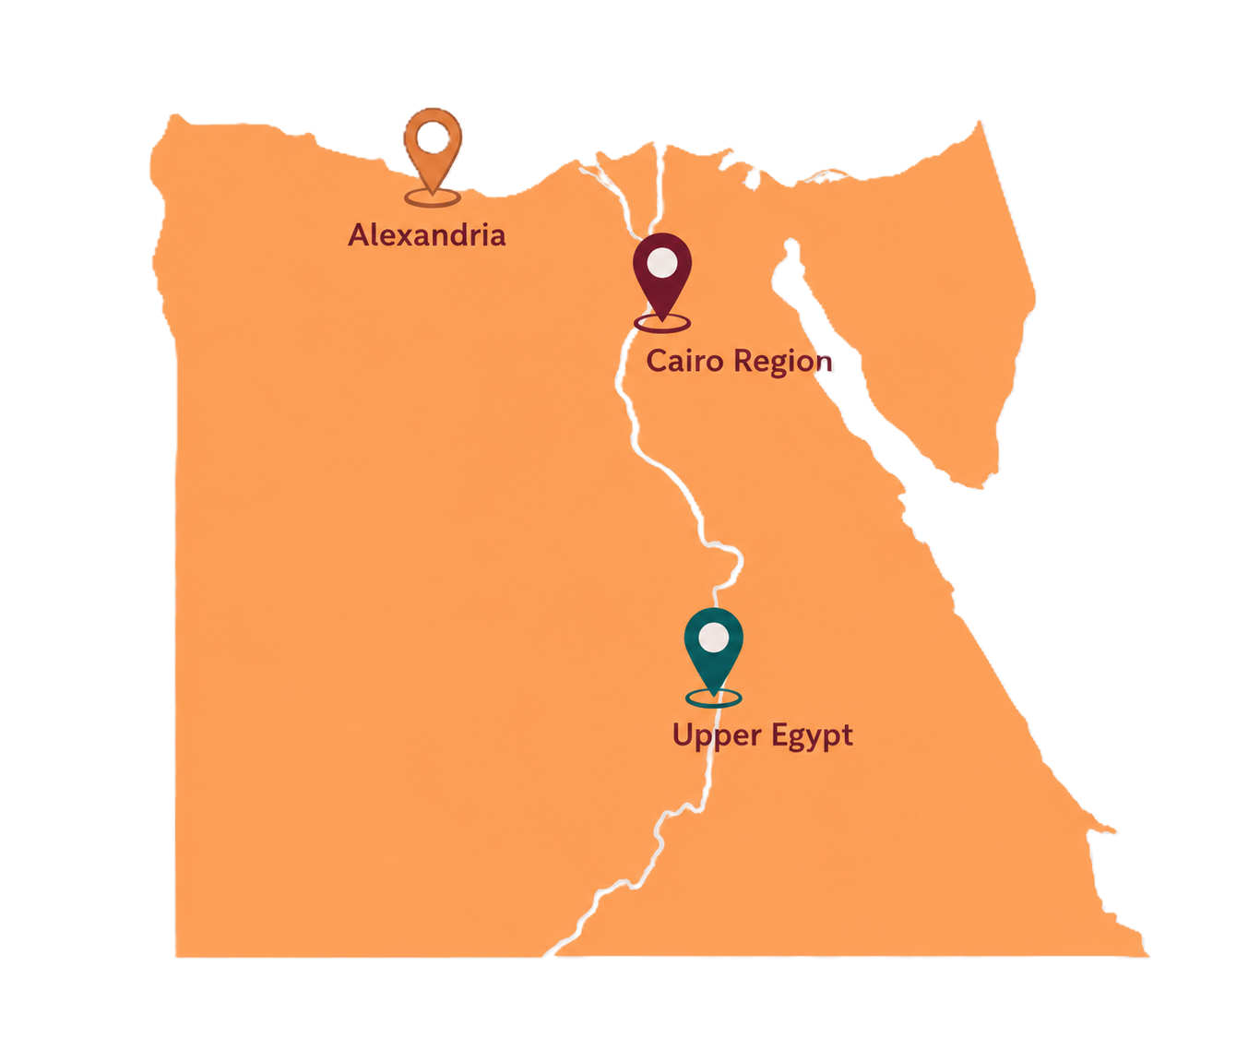
Egypt Pharmaceutical Market
Cairo Region
Greater Cairo — Egypt's largest pharmaceutical market
Alexandria
Alexandria — second-largest market; key distribution hub for northern Egypt
Upper Egypt
Upper Egypt — emerging market with growing pharmaceutical retail penetration

Slide 92
Regional Performance Summary
Upper Egypt Opportunity
Greater Cairo: EGP 54.88B (49.5% share, +32.3%) — DEFENSIVE market. Delta: EGP 26.45B (23.8%, +32.3%) — Acceleration needed. Upper Egypt: EGP 15.71B (14.2%, +37.8%) — FASTEST growing, massive underpenetration (40% of population). Alexandria: EGP 11.78B (10.6%, +27.5%) — Below national, monitor. Canal Zone: EGP 2.08B (1.9%, +27.8%) — Weakest CAGR, volatile.
Upper Egypt: 14.2% market share vs. 40% of Egypt’s population = 25-point underpenetration gap. If Upper Egypt reaches 20% share, that is an additional EGP 6.4 Billion in revenue. Growth already +37.8% above national average — first movers capture disproportionate share. Top targets: Kafr El Sheikh (+92%), Aswan (+73%), Sohag (+53%), Qena (+51%).

Slide 93
Governorate Opportunity Tiers
STAGNANT TIER
ANOMALY
PREMIUM OPPORTUNITY
EXPLOSIVE TIER
OUTPERFORMER TIER
IN-LINE TIER
Fayoum +3%, Ismailia +6%, Suez +1%
Port Said +176.4% — investigate
Aswan +72.7%, avg EGP 106/unit
Kafr El Sheikh +92%, Aswan +73%, Sohag +53%
Gharbia +45%, Minya +44%, Beni Suef +38%
Cairo +32%, Monufia +33%, Dakahlia +20%

Slide 94
Strategic Opportunity
SGLT2 Diabetes Portfolio | Why This Opportunity | Business Potential

Slide 95
Why NOT the Alternatives?
Alternative Considered | Why Rejected
GLP-1 (OZEMPIC/MOUNJARO tier) | Duopoly — Eli Lilly (52.9%) + Novo Nordisk (44.5%) own 97.4%. Entry requires biosimilar at 80% price discount — margin destructive.
Vitamins/Supplements (A11) | HHI = 0.12, 243 corps — most fragmented class. Too many undifferentiated competitors. Limitless Naturals already owns the narrative.
Anti-infectives (J01, +17.9%) | Below market growth rate. Generic pressure severe. Market is commoditized — no pricing power.
PPIs / Antacids (A02, 34% of market) | ZURCAL already dominates as local generic. CONTROLOC losing. AUG PHARMA owns this category — HHI 0.10 but AUG has decisive brand advantage.
Wound Healing / PANTHENOL (D03, +65%) | Two companies (PANTHENOL, MEBO) own 90% of a EGP 2.17B market — rapid consolidation post-boom. Entry window is closed.

Slide 96
Strategic Opportunity: SGLT2 Diabetes Portfolio
01
02
Market Size
Demand
04
03
Competition
Geography
Diabetes: EGP 14.51B — Egypt’s LARGEST ATC2 class. YoY +54.1%. SGLT2/DPP-IV target segments = EGP 7.58B growing 20-97% annually. SGLT2+DPP-IV Combo doubling annually (+97.8%).
9.3M diabetics, only 30% controlled = 6.5M undertreated. SGLT2 cardio-renal benefits unlock hospital channel.
HHI <0.16 — no player over 20% share. GLP-1 closed (duopoly). SGLT2 combinations OPEN.
Upper Egypt: 12.3% of diabetes market vs 40% population. First mover in Minya, Assiut, Sohag = 3-4x upside.

Slide 97
Launch Strategy
 | PHASE 1 (Months 1-6): SCIENTIFIC FOUNDATION — Build KOL relationships in Endocrinology at Cairo University, Ain Shams, and Alexandria Medical School. Sponsor a local clinical registry for SGLT2 use in Egyptian T2DM patients. Position the brand with a cardiovascular/renal benefit narrative (not just glucose control). PHASE 2 (Months 6-18): COMMERCIAL LAUNCH — Priority launch in Greater Cairo hospital formularies (Stores channel) targeting HbA1c >8% uncontrolled T2DM. Simultaneously list in Top-200 private pharmacies in Greater Cairo and Alexandria. Target Cardiologists alongside Endocrinologists — SGLT2 cardio-renal indication opens a secondary prescriber base. PHASE 3 (Months 18-36): GEOGRAPHIC EXPANSION — Deploy dedicated team to Minya, Assiut, Sohag (Upper Egypt) with government hospital formulary targeting. Upper Egypt government hospitals see the highest volume of uncontrolled T2DM. Launch patient support program for adherence.
Pricing Strategy
★ | Recommended Price Architecture
 | SGLT2 Plain (e.g., Dapagliflozin 10mg 30 tabs): Launch at EGP 280-320 — premium vs. pure generics (EGP 180-200) but below originator Forxiga (EGP 602). SGLT2 + Metformin Combo: EGP 220-260 — combination value proposition justifies premium over mono-therapy. SGLT2 + DPP-IV Combo (premium positioning): EGP 350-400 — targeting Jardiance/Synjardy territory (Boehringer, EGP 300-400 range) with superior local service. RATIONALE: Egyptian prescribers are trained on EGP price bands. 35-45% below originator with comparable quality profile captures price-sensitive hospitals while maintaining margin. DO NOT compete at the generic bottom (EGP 130-180): This destroys brand equity and positions you in a commodity war against 40+ domestic generics.

Slide 98
Promotional Focus
 | PRIMARY MESSAGE: 'Beyond Glucose Control' — position SGLT2 on the cardiovascular + renal protection benefit. This message differentiates from all generic competitors who communicate only HbA1c reduction. TARGET SPECIALTIES: Endocrinology (60% of prescriptions), Internal Medicine (25%), Cardiology (10%) — cardiologists are the fastest-growing prescriber segment for SGLT2 as cardiovascular outcome data matures. DIGITAL CHANNEL: Egypt has strong physician digital adoption — invest in pharma-specialized digital detailing platforms and CME sponsorship via Medscape Arabia and local medical associations. PATIENT ENGAGEMENT: Offer adherence program (free glucose monitoring strips, pharmacy partnership) — SGLT2 has once-daily dosing advantage. Adherence marketing differentiates from competitors. KEY MESSAGE FOR UPPER EGYPT: Emphasize simplified dosing, combination pill convenience (fewer tablets), and government hospital tender pricing. Price is #1 barrier in Upper Egypt — not clinical skepticism.
Competitive Positioning
 | vs. FORXIGA (AstraZeneca): Growing only +14% despite being market leader. AstraZeneca is not investing commercially in Egypt (total company -0.8%). Vulnerable to a well-resourced challenger offering equal quality at lower price + superior service. vs. JARDIANCE (Boehringer Ingelheim): Limited commercial presence in Egypt. Scientific positioning as premium brand but underinvesting in market development. Can be outmaneuvered in Upper Egypt and hospital accounts. vs. Domestic SGLT2 generics (40+ products): Differentiate on: (1) consistent quality/manufacturing standards, (2) full combination portfolio breadth, (3) clinical support programs, (4) physician relationships. Price alone will not win — the market is already at commodity pricing for pure generics.

Slide 99
Geographic Targeting Priority
Priority | Target | Rationale | Channel | Investment Level
1 | Greater Cairo Hospitals | 50% of national diabetes market | Stores (Hospital) | HIGH — establish formulary first
2 | Alexandria Private Hospitals | #3 city + highest Stores% (43.7%) | Stores + Pharmacies | HIGH — dual channel
3 | Minya, Assiut (Upper Egypt) | Fastest growing, lowest penetration, government hospital density | Stores (Gov Hospitals) | MEDIUM — high ROI on low base
4 | Gharbia, Sharqia (Delta) | Delta growing +37-45%, large diabetic population | Pharmacies | MEDIUM — retail-focused
5 | Sohag, Qena, Aswan | Explosive growth, very low penetration, high unmet need | Stores (Gov) | MEDIUM — Year 2 priority
KPI Framework for Commercial Tracking
KPI | Target Year 1 | Target Year 2 | Target Year 3 | Measurement
Total SGLT2 Portfolio Sales | EGP 120M | EGP 280M | EGP 520M | IQVIA MAT report
Market Share in SGLT2 plain (A10P1) | 2.5% | 5.0% | 8.0% | IQVIA product share
Market Share in SGLT2+DPP-IV (A10P5) | 4.0% | 9.0% | 15.0% | IQVIA — growing segment
Hospital Formulary Listings | 40 hospitals | 120 hospitals | 250 hospitals | Sales force reporting
Upper Egypt Revenue Contribution | 10% of portfolio | 18% of portfolio | 25% of portfolio | IQVIA regional data
Prescribing Physicians (active) | 800 | 2,000 | 4,500 | CRM system
Growth vs. Segment (outperformance) | 5% above segment | 8% above segment | 10% above segment | IQVIA comparison

Slide 100
Thanks!

